Slide 1
Fully-Convolutional Siamese Networks for Object Tracking
[Paper overview]
Luca Bertinetto, Jack Valmadre, Joao F. Henriques, Andrea Vedaldi, and Philip H.S. Torr
Department of Engineering Science, University of Oxford, Oxford, UK
Published in the European Conference on Computer Vision (ECCV)-2016
Presented by: Md. Maklachur Rahman

Slide 2
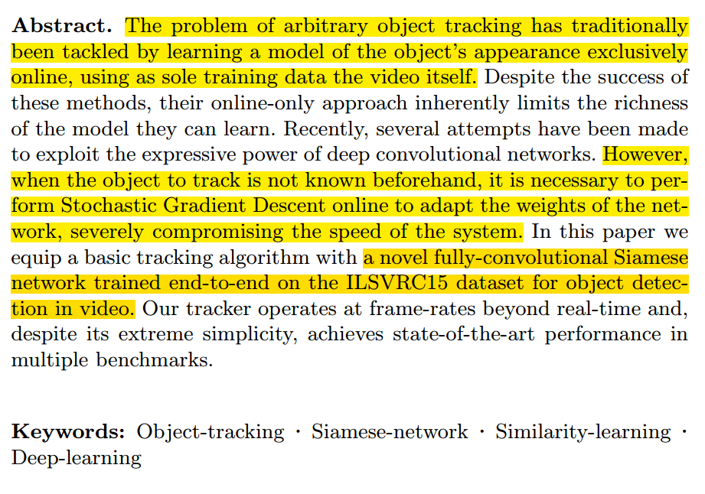
Summary:
Tracking an arbitrary object, online learning strategies are traditionally used to learn appropriate tracking model but the speed is really slow.
However, since target is not known in advance, a Stochastic Gradient Descent algorithm needs to be performed online to adjust the network weight each time, which seriously affects the speed of the tracking system.
In this paper, a novel fully-convolutional Siamese network is trained end-to-end on the ILSVRC15 dataset for object detection that gives the real-time facility for tracking.

Slide 3
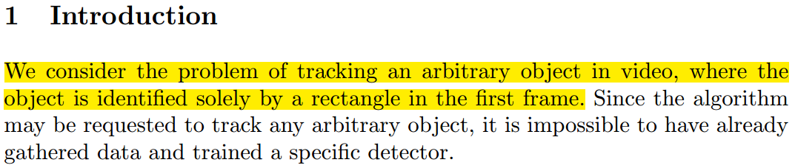
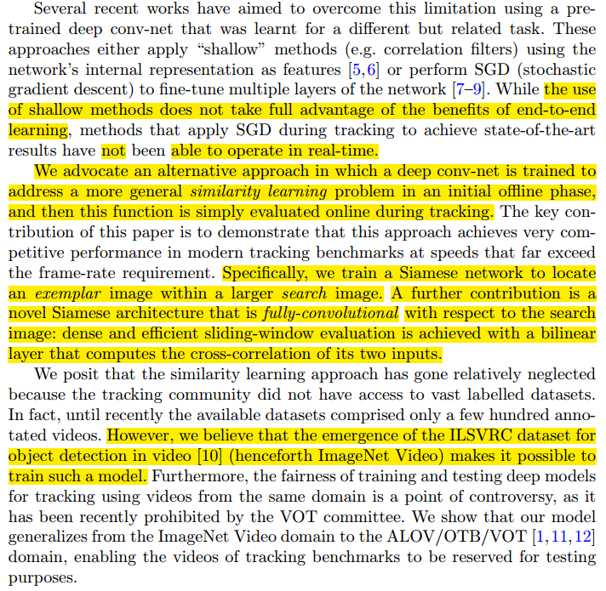
Introduction:
Siamese networks are a special type of neural network architecture. In this model, instead of learning to classify its inputs, it learns to differentiate between two inputs i.e. It can learn the similarity between them.
A Fully-Convolutional Siamese Networks is introduced and the main task of this network is to learn a similarity comparison between the target/exemplar image and search/candidate image.
Siamese conv-net trained to address a similarity learning problem in an offline phase.
Here, training a Siamese network to locate an exemplar image within a larger search image and Image-net 2015 (ILSVRC15) training data that is used to train this network is the video used for target tracking.

Slide 4
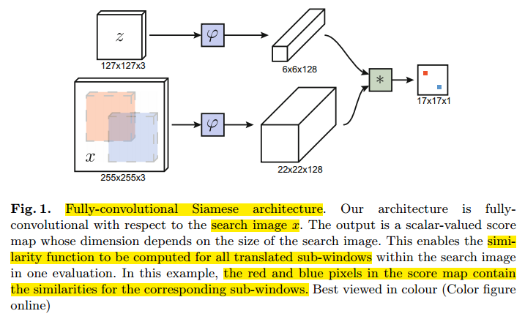
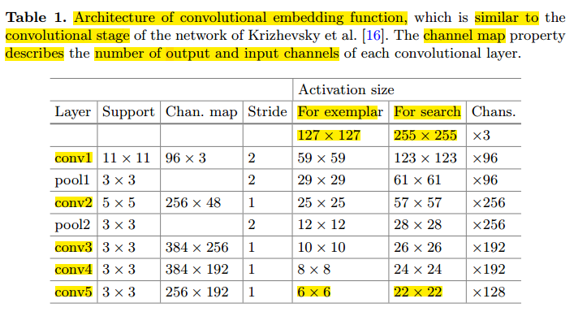
2. Deep Similarity Learning for Tracking
Overall architecture of the FC Simaese:
This network is fully convolutional because there is no fully-connected layers.
Two inputs of different sizes: smaller(z) is the exemplar (target object during tracking), bigger(x) is the search area.
The conv-net learns a function that compares an exemplar z to a candidate of the same size x’.
Cross-correlation layer: computes the similarity at all translated sub-windows on a dense grid in a single evaluation.
In addition, output is a score map that contain the similarities for the corresponding sub-windows.
After embedding some convolutional and pooling layer they get (6*6*128) and (22*22*128) feature maps for exemplar image and search image respectively.
From Figure 1, we can easily understand that framework itself compares the similarity between the search area and the target template, and finally obtains the score map of the searched area based on the highest similarity between x and z among the all translated slide windows.

Slide 5
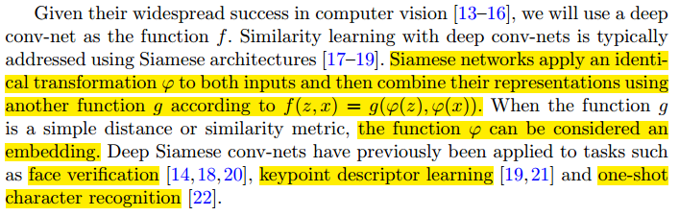
Similarity Learning for tracking:
They proposed to learn a function f(z, x) that compares an exemplar image z to a candidate image x of the same size and returns a high score if the two images depict the same object and a low score otherwise.
Siamese networks apply an identical transformation ϕ to both inputs and then combine their representations using another function g according to f(z, x) = g(ϕ(z), ϕ(x)).
When the function g is a simple distance or similarity metric, the function ϕ can be considered an embedding.
The advantage of a fully-convolutional network is that, instead of a candidate image of the same size, we can provide as input to the network a much larger search image.
The output of this network is not a single score but rather a score map.

Slide 6
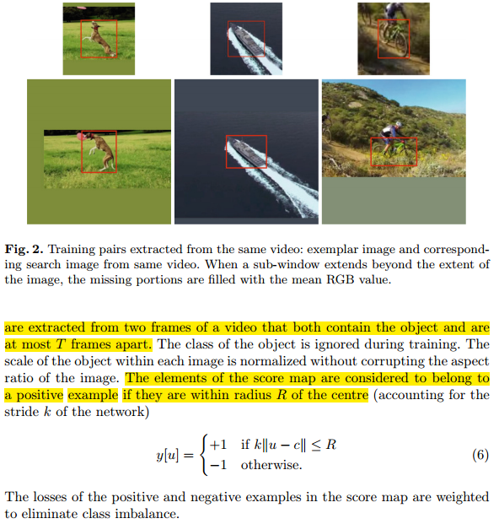
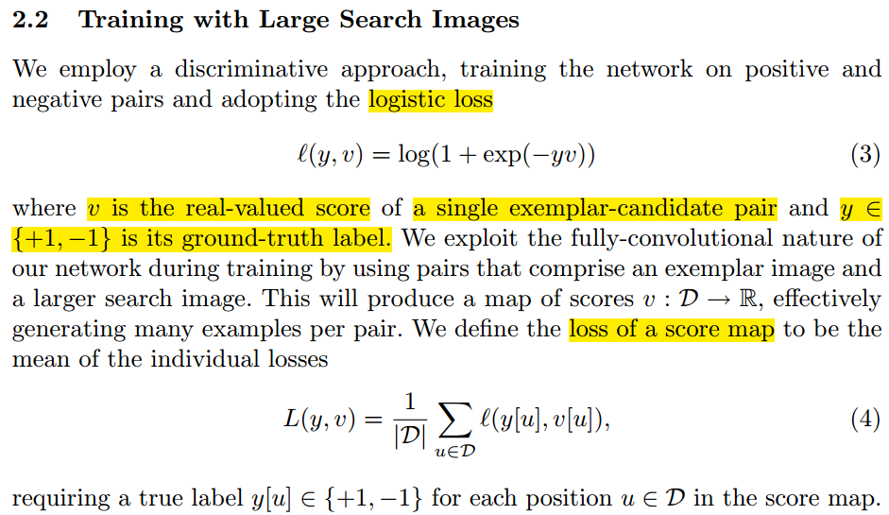

Slide 7
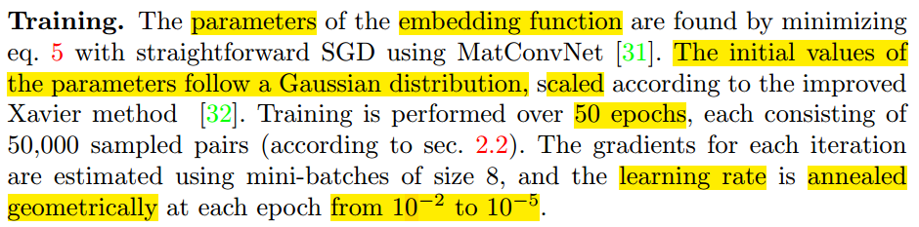
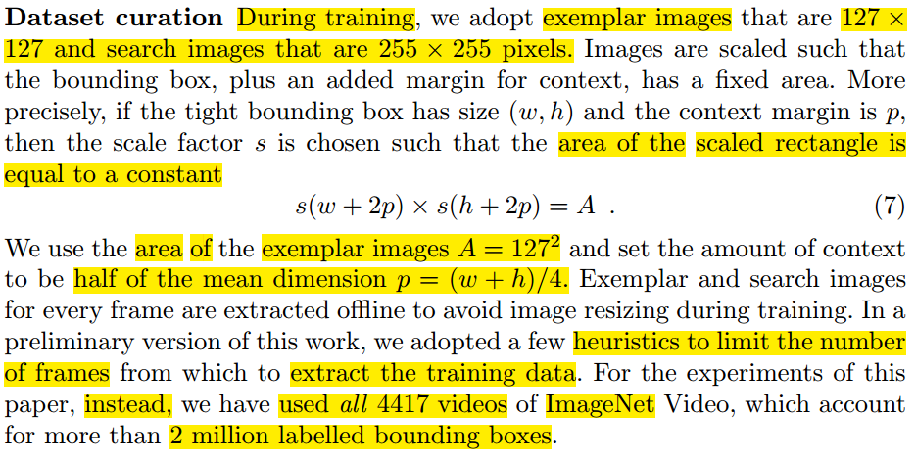

Slide 8
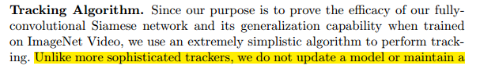
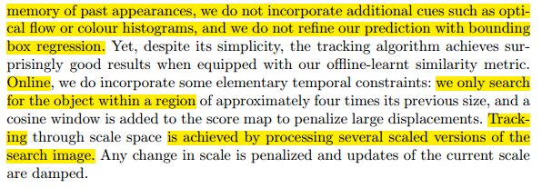
Unlike more sophisticated trackers, they do not update a model or maintain a memory of past appearances.
Similarly, they do not incorporate additional cues such as optical flow or color histograms, and they do not refine the prediction with bounding box regression.
This method does not perform any model update, so it uses only the first frame to compute ϕ(z).
Tracking through scale space is achieved by processing several scaled versions of the search image.

Slide 9

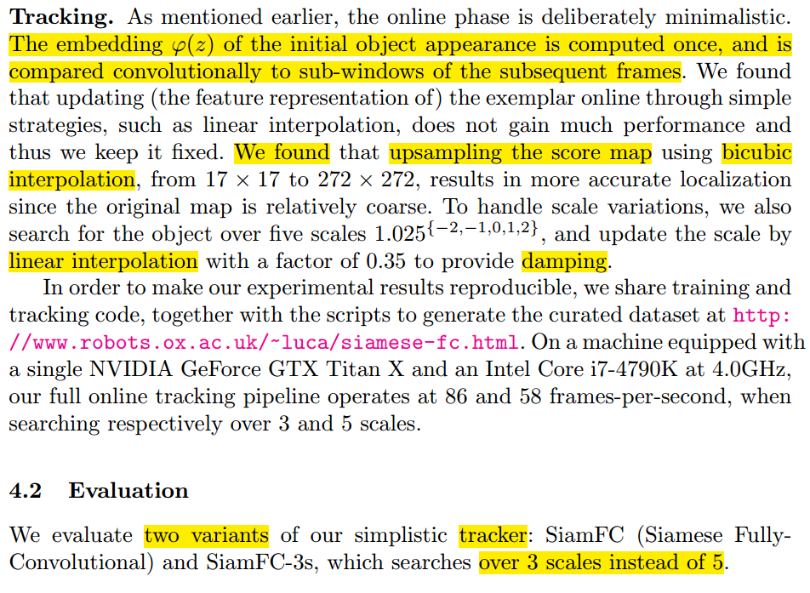
Training is performed over 50 epochs, each consisting of 50,000 sampled pairs. The gradients for each iteration are estimated using mini-batches of size 8, and the learning rate is annealed geometrically at each epoch from 10^(−2) to 10^(−5).
The embedding ϕ(z) of the initial object appearance is computed once, and is compared convolutionally to sub-windows of the subsequent frames.
To handle scale variations, they also search for the object over five scales 1.025{−2,−1,0,1,2}, and update the scale by linear interpolation with a factor of 0.35 to provide damping.
To evaluate this tracker they use searches over 3 scales instead of 5. It also help to avoid to compromise some tracking speed.

Slide 10
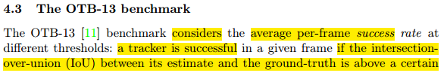
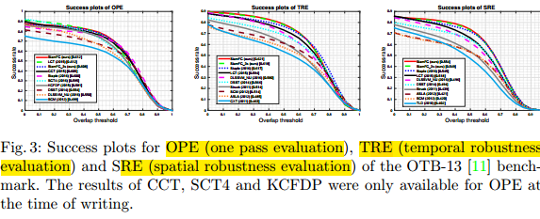
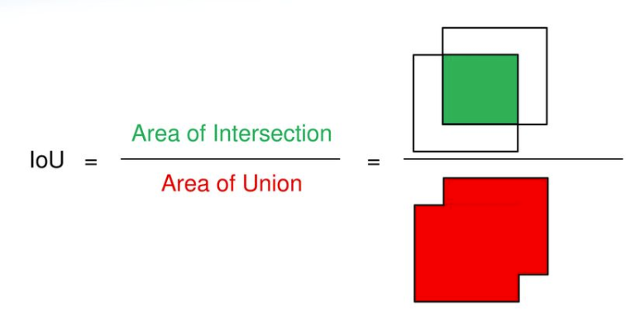
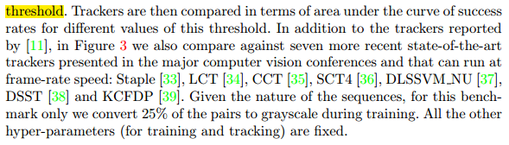
Overlap threshold VS Success rate:
It considers the average per-frame success rate at different thresholds: a tracker is successful in a given frame if the intersection over-union (IoU) between its estimate and the ground-truth is above a certain threshold.
IoU Image credit: https://slideplayer.com/slide/12753498/

Slide 11
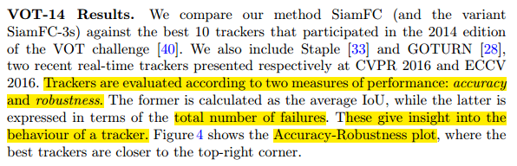
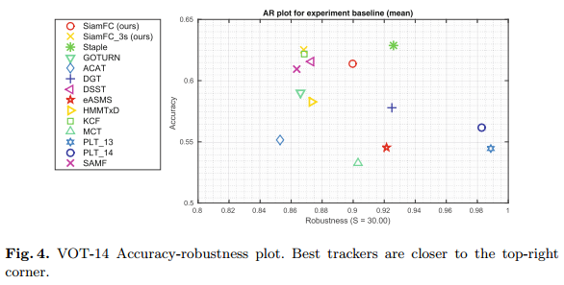
Robustness VS Accuracy:
Trackers are evaluated according to two measures of performance: accuracy and robustness.
Here, they computed total number of failures of the tracker.
It gives insight the behavior of a tracker. The shows the Accuracy-Robustness plot, where the best trackers are closer to the top-right corner.

Slide 12
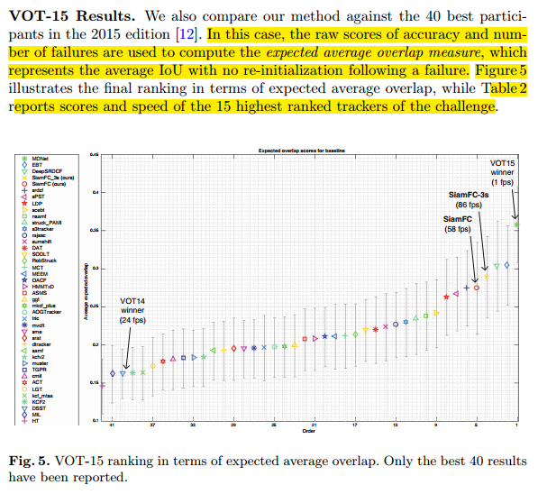
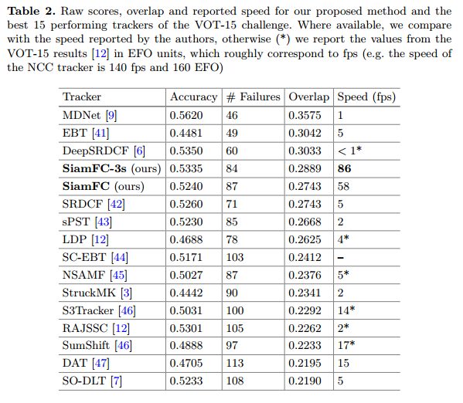

Slide 13
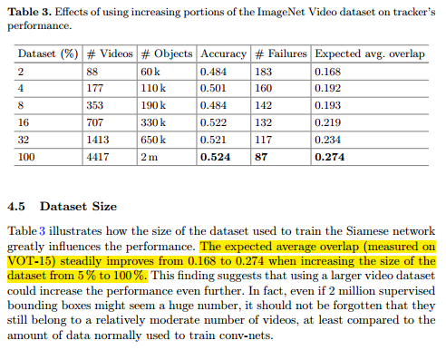
Roles of Dataset set for expected average overlap:
The expected average overlap (measured on VOT-15) steadily improves from 0.168 to 0.274 when increasing the size of the dataset from 5 % to 100 %.
Similarly, we can say that less percent of dataset gives less expected average overlap as well as more dataset gives us the better expected result.

Slide 14
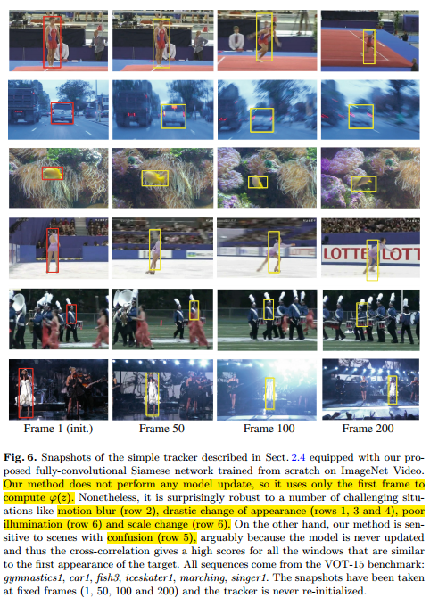
Despite the simplicity of this method, it is improved as recent state-of-the-art real-time trackers.
Similarity metric learnt by their fully-convolutional Siamese network on ImageNet Video alone is enough to achieve very strong results, comparable or superior to recent state-of-the-art methods.
Nonetheless, it is surprisingly robust to a number of challenging situations like motion blur (row 2), drastic change of appearance (rows 1, 3 and 4), poor illumination (row 6) and scale change (row 6). On the other hand, our method is sensitive to scenes with confusion (row 5).

Slide 15
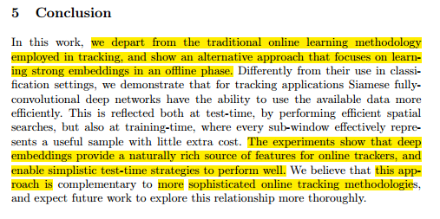
Conclusion:
They depart from the traditional online learning for tracking but an alternative approach that focuses on learning strong embedding in an offline phase then tracking online.
The experiments show that deep embedding provide a naturally rich source of features for online trackers, and enable simplistic test-time strategies to perform well.
This approach is complementary to more sophisticated online tracking methodology.
It can operates 86 fps that is highest among the other trackers.

Slide 16
Thank you…

